Slide 1
Chapter 12: Confirmatory Factor Analysis

Slide 2
Introduction
EFA: Used to identity a test’s internal structure
Confirmatory Factor Analysis (CFA): Also used to identify a test’s internal structure.
So when to use which???
  EFA == Not sure how many factors (hence the “exploratory” part)
  CFA == You have strong/clear theoretical expectations for how many factors there should be
Notes:
Key implications for test’s development, reliability, validity, and use:
Test development: Internal structure is considered majorly when constructing a new test or scale.
Reliability: Evaluation of a test’s dimensionality reveals which items are consistent with which other items.
Validity: A test’s internal structure is important because the appropriate interpretation of scores depends on the match between its actual and intended internal structures.
Use: Internal structure must guide the way a test is scored, producing one or more psychologically and quantitatively meaningful scores.
Exploratory factor analysis (EFA):
A statistical tool used to evaluate a test’s dimensionality.
Most appropriate with few hypotheses about a scale’s internal structure.
Confirmatory factor analysis (CFA):
Designed to examine a test’s dimensionality when there are clear expectations about the number of factors or dimensions underlying a test’s items, the links between the items and factors, and the association between the factors.
Uses of confirmatory factor analysis:
It examines various crucial psychometric issues.
It examines a test’s internal consistency.
It evaluates convergent and discriminant evidence.

Slide 3
On the Use of EFA and CFA (1 of 2)
EFA is used more frequently than CFA.
  Why?
    Software packages like SPSS default to EFA
    Not always sure how many factors
EFA and CFA useful for different phases of test development.
  EFA helps w/ clarifying understanding of constructs
  CFA is typically used after initial evaluations and revising test content
Suggestion: Start w/ EFA first!
Notes:
EFA is used more frequently than CFA:
This discrepancy is a result of seamless integration of EFA into user-friendly and widely used statistical packages.
Example: While EFA has long been integrated into the popular SPSS statistical package, the ability to conduct CFA in SPSS emerged later and still requires additional software components.
Emerging interest and application of CFA:
This emergence might be due to the growing availability and user-friendliness of statistical software that is capable of conducting CFA.
Statistical packages such as R, SAS, Mplus, and SPSS are relatively straightforward for CFA and include modules that conduct CFA.
Example: When using the AMOS package in SPSS, CFA can be conducted by only creating figures to represent hypotheses about a test’s dimensionality.
EFA and CFA useful for different phases of test development: While EFA is most useful when test developers clarify their understanding of the constructs and of the test itself, CFA is more useful after the initial evaluations of item properties and dimensionality and after significant revisions of test content.
Hypothesis-driven versus exploratory approach:
While EFA is used in a hypothesis-driven way, CFA is often used in an exploratory way.
The technique of exploratory structural equation modeling blends both exploratory and confirmatory factor-analytic procedures, with benefits of both methods.

Slide 4
On the Use of EFA and CFA (2 of 2)
Understanding the degree of consistency between hypothesized structure and actual data
Example: Hypothesis that self-esteem is just one factor. Build scale → Collect data → run CFA.
Hypothesis can be updated as needed
Notes:
Understanding the degree of consistency:
With CFA, test developers and evaluators can understand the degree to which their hypothesized measurement models are consistent with actual data.
Example: If we hypothesize that the RSEI has a unidimensional structure, we can test this “model” formally using CFA, by collecting responses to the RSEI items and examining the degree to which those actual responses produce data in which the RSEI items cohere into a single factor.
Altering hypothesized model to be consistent:
It is possible to alter our hypothesized model to make it more consistent with the actual structure of responses to the test.
Example: If the CFA of the RSEI indicates that the actual responses are not consistent with a unidimensional model, we can modify our hypothesis regarding the true structure of the RSEI.
Examining measurement models in a series of CFAs:
This can be done using the results to discover the one that best matches participants’ actual responses.
Example: By formally testing the RSEI’s “fit” with both a unidimensional model and a two-dimensional model, we can find which model is more consistent with the actual test responses.

Slide 5
Using CFA for Analysis of a Scale’s Internal Structure
(1 of 11)
CFA is an iterative process
  Starts w/ a specific model design
  Model is evaluated
  Hypothesis is revised
  Repeat if needed (but maybe not too much?)
Notes:
CFA: an iterative, back-and-forth process:
The process begins with articulation and evaluation of a specific measurement model.
Then, the model is revised and the revised model is evaluated.
Revision and reevaluation of models can occur multiple times as we learn more and more from the CFA process.
Key information reported about model-testing process:
It includes any revisions that have been made to the model(s).
It highlights the measurement model that is most consistent with the test’s actual internal structure.
Example of the Authenticity Scale:
This scale was intended to measure the degree to which a person “knows himself or herself” and “acts accordingly.”
It was based on a model that identifies three dimensions of authenticity.

Slide 6
Using CFA for Analysis of a Scale’s Internal Structure
(2 of 10)
Example: Authenticity Scale
  Measures degree to which a person “knows themselves” and “acts accordingly”
  Based on a 3-dimension model of authenticity
Self-alienation: degree of knowing oneself.
Authentic living: degree of expressing emotions honestly.
Accepting external influence: degree of knowing influence of others.
Notes:
CFA: an iterative, back-and-forth process:
The process begins with articulation and evaluation of a specific measurement model.
Then, the model is revised and the revised model is evaluated.
Revision and reevaluation of models can occur multiple times as we learn more and more from the CFA process.
Key information reported about model-testing process:
It includes any revisions that have been made to the model(s).
It highlights the measurement model that is most consistent with the test’s actual internal structure.
Example of the Authenticity Scale:
This scale was intended to measure the degree to which a person “knows himself or herself” and “acts accordingly.”
It was based on a model that identifies three dimensions of authenticity.

Slide 7
The Process of CFA for Analysis of a Scale’s Internal Structure
(3 of 10)
CFA Preliminary Steps
  Clarify your construct/dimensions!
  Collection responses! (The more the merrier, seriously!)
  Reverse scoring any negatively keyed items
Notes:
Clarification of psychological construct and initial development of test:
This is the first preliminary step.
Wood et al. described a process of writing a large number of items, an initial analysis of some responses to those items, and a selection of four items for each of the three intended dimensions, which produced a total of 12 items that passed initial tests of psychometric quality.
Collection of large number of responses to test:
A variety of recommendations have been offered by experts for the sample size of a CFA.
For absolute numbers of respondents, recommendations range from a minimum of 50 people to 400 people or more.
For the ratio of respondents to items, suggestions range from 5 respondents per item to 20 or more respondents per item.
As a complex multivariate procedure, CFA requires a large number of responses (i.e., more than 200 respondents).
Reverse scoring of negatively keyed items:
This ensures that every item is keyed in the same direction.
It avoids any confusion arising from items that might otherwise seem highly inconsistent with each other.

Slide 8
The Process of CFA for Analysis of a Scale’s Internal Structure
(4 of 10)
CFA Analysis Steps:
  Figure out the statistical package you want to use (probably SPSS, but R is better)
  Specify number of dimensions, factors, latent variables etc.
  Links or associations between factors items?
  Run the thing!
Notes:
Using statistical software package to conduct CFA:
Once the three preliminary steps are performed, the hypothesized measurement model is transferred into a statistical software package designed to conduct CFA.
The process can be straightforward with the use of packages such as AMOS/SPSS, SAS, EQS, LISREL, Mplus, or R.
Some of these packages allow us simply to draw a figure to represent the measurement model and these drawings are translated into statistical equations, which are used to conduct the CFA.
We can also create those equations directly using these packages without having to draw a figure.
Elements to be specified in the model:
The number of dimensions, factors, or latent variables that are hypothesized to underlie the test’s items.
The links between items and factors.
Guidelines followed when specifying links:
In most measurement models, at least one item is linked to each factor.
Each item is typically linked to only one latent variable since the item reflects only one psychological characteristic.
The potential associations between factors (if more than one factor is hypothesized).
Two ways of indicating that factors are associated with each other:
Specifying that the factors load on a higher order factor.
Having factors be correlated with each other by using a two-way arrow between them.
Specifying hypothesis for existence of link/association:
We hypothesize that an item is associated with a particular factor or not.
We also hypothesize that factors are associated with each other or not.
The statistical software will then estimate the precise associations.
If there is a pathway between an item and a factor (or between two factors), then it indicates a hypothesized nonzero association.
Conversely, if the pathway is absent, it indicates a hypothesized zero association.

Slide 9
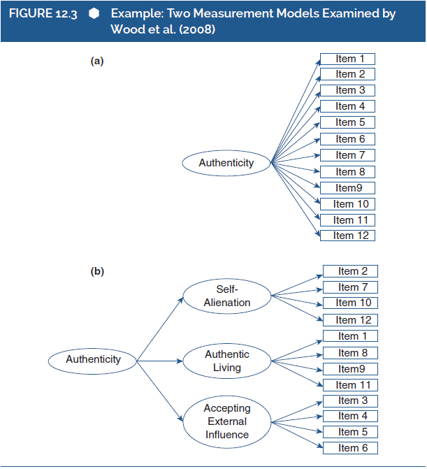
The Process of CFA for Analysis of a Scale’s Internal Structure
(5 of 10)
Notes:
Figure 12.3: Example: Two measurement models examined by Wood et al. (2008).

Slide 10
The Process of CFA for Analysis of a Scale’s Internal Structure
(6 of 10)
Interpreting CFA Output
  Software compares predicted variance/covariance w/ actual variance/covariance from model
  Indices of model fit.
Good fit == little or no mismatch
Modification indices: ways of improving measurement models.
  Some stats programs wills give specific suggestions
Notes:
Phase 4: Indices of model fit:
In this phase, information about the general adequacy or “fit” of the hypothesized model is produced by the software.
This is done by comparing the implied variances/covariances with the actual variances/covariances.
Condition of good fit indices:
Occurs if only minor discrepancies or mismatches are found when comparing implied and actual values.
Indicates that the hypothesized measurement model reflects the actual pattern of the test responses.
Condition of poor fit indices:
Occurs if large discrepancies or mismatches are found when comparing implied and actual values.
Indicates that the hypothesized measurement model does not reflect the actual pattern of the test responses.
Modification indices:
These values indicate specific ways of improving measurement models.
They reveal potential modifications that would bring the model closer to the factor structure that may be underlying the test’s items.

Slide 11
The Process of CFA for Analysis of a Scale’s Internal Structure
(7 of 10)
Interpreting CFA Output
  Fit indices: Statistics that address the overall adequacy (or terribleness) of our hypothesized model
  Better fit == better confidence
Most commonly reported: Chi-square statistic (misfit of the model)
Notes:
Examining the fit indices:
These indices address the overall adequacy of our hypothesized measurement model.
If the fit indices are good, then we can have initial confidence in interpreting the dimensionality of the test as we hypothesized.
If the fit indices are poor, then it indicates that the hypothesized measurement model is not consistent with the actual responses to the test.
Calis procedure of statistical package SAS:
It computes approximately 20 fit indices.
It is used to conduct CFA.
Chi-square statistic:
The most commonly reported fit index.
Range: greater than or equal to 0.
Indicates the degree of “poorness of fit” or “misfit” of the model.
Large, significant chi-square values are evidence of poor fit, whereas small, nonsignificant chi-square values indicate good fit.
Affected by the sample size where large sample size would result in poor fit.
Alternative indices of chi-square statistic:
Goodness-of-fit index (GFI).
The incremental fit index (IFI).
The normed fit index (NFI).
The comparative fit index (CFI): ranges from 0 to 1.0; larger values indicate good fit.
The nonnormed fit index (NNFI or the Tucker-Lewis Index, or TLI): ranges from 0 to 1.0; larger values indicate good fit.
The root mean square error of approximation (RMSEA): ranges from 0 to 1.0; smaller values indicate good fit.
The root mean square residual (RMR): range: greater than or equal to 0; smaller values indicate good fit.
The standardized root mean square residual (SRMR): ranges from 0 to 1.0; lower values indicate good fit.
The Akaike information criterion (AIC).

Slide 12
The Process of CFA for Analysis of a Scale’s Internal Structure
(8 of 10)
Fit Index | Three factor Model | One Factor Model | Cited Benchmark
Chi-square | 90.06^{*a} | 353.45^{*b} | NA
SRMR | .08 | .16 | <.08
CFI | .94 | .53 | >.95
RMSEA | .06 | .16 | <.06
Notes:
Table 12.3: Fit indices for two measurement models examined by Wood et al. (2008): Sample 3 (N = 213).
Note: Benchmarks are those cited by Wood et al. (2008). NA = No benchmark cited, as it is the statistical significance of the chi-square test that is used to evaluate model fit; SRMR = standardized root mean square residual; CFI = comparative fit index; RMSEA = root mean square of approximation.
*p <.05.
ªdf = 51.
^{b}df = 54.

Slide 13
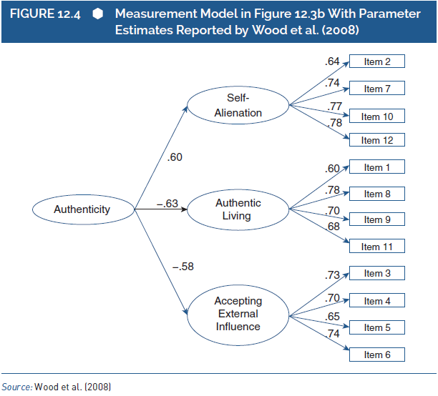
The Process of CFA for Analysis of a Scale’s Internal Structure
(9 of 10)
Notes:
Figure 12.4: Measurement model in Figure 12.3b with parameter estimates reported by Wood et al. (2008).
Source: Wood et al. (2008).

Slide 14
The Process of CFA for Analysis of a Scale’s Internal Structure
(10 of 10)
Final Steps:
  Modify if needed
  Analyze and evaluate revised model.
Cautions regarding modification in a CFA.
  Too exploratory? Might as well just do EFA
  Modifications should be grounded in theory!
Notes:
Obtaining and examining modification indices:
Obtaining the modification indices:
When we conduct a CFA, a large number of modification indices is obtained.
Each index represents a parameter that was left out of the initial measurement model.
Examining the modification indices:
The magnitude of a modification index reflects the potential impact of revising or modifying the relevant parameter.
When we examine the modification indices and make changes based on the largest indices, we learn about the real dimensionality of the test.
Analyzing and evaluating revised model:
Analysis will produce new output which includes new fit indices, new parameter estimates, and so on.
We then evaluate the adequacy of the revised model, and we either examine parameter estimates (if the revised model fits well) or examine the new modification indices (if the model still fits poorly).
Cautions regarding modification in a CFA:
It obscures the difference between confirmatory analysis and exploratory analysis.
A test developer or test evaluator might be hesitant to perform many modifications, particularly to those that lack a clear conceptual justification.
Drawback of revising the test: This requires us to collect completely new data from a new set of respondents thereby extending the test development and validation process.

